Slide 1
STARTUP
Unit 3

Slide 2
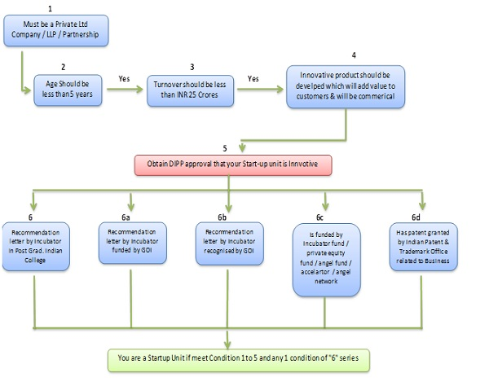
WHAT IS A STARTUP?

Slide 3
Startup India Benefits
1. IPR Benefits
Fast-tracking of Startup patent applications.
Panel of facilitators to assist in filing of IP applications.
Government to bear facilitation cost.
Rebate on filing of application.

Slide 4
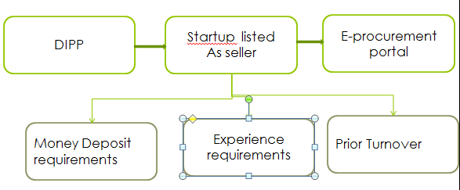
Relaxation in Public Procurement Norms
Notes:
buying of goods and services by government organizations
Department of Industrial Policy & Promotion

Slide 5
Self-Certification under Labour and Environment Laws
To reduce the regulatory burden
self-certify their compliance under 6 Labour and 3 Environment laws 6 Labour and 3 Environment laws
Notes:
he practice of giving information about oneself or one's company in a formal statement rather than being obliged to ask a third party to do so.

Slide 6
Fund of Funds for Startups
equity funding support of 10,000 crores managed by SIDBI.
The Fund is in the nature of Fund of Funds, which means that the Government participates in the capital of SEBI registered Venture Funds, who further invest in Startups.
Notes:
SIDBI :: Small Industries Development Bank of India
The Fund is in the nature of Fund of Funds, which means that the Government participates in the capital of SEBI registered Venture Funds, who further invest in Startups.
Venture capital funds are investment funds that manage the money of investors who seek private equity stakes in startup and small- to medium-sized enterprises with strong growth potential.

Slide 7
Faster Exit for Startups
MCA has notified Startups as ‘fast track firms’ enabling them to wind up operations within 90 days

Slide 8
Tax Exemption
IMB Certified
The Inter-Ministerial Board validates tax related benefits constituted by representatives from DIPP,
Startups incorporated on or after 1st April 2016 can apply for tax benefits

Slide 9
Tax Exemption for 3 years
Income-tax for a period of 3 years
Tax Exemption on Investment above Fair Market Value
receives any consideration for issue of shares that exceeds the face value of such
Notes:
Fair market value is the price of an asset when both buyer and seller have reasonable knowledge of the asset and are willing and unpressured to trade

Slide 10
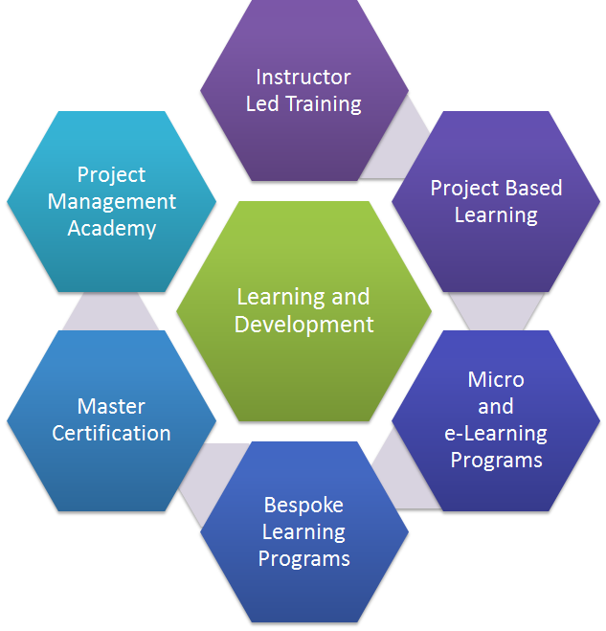
RESOURCES FOR STARTUPS
Learning and Development Program
.
Notes:
The program covers lessons on key areas of starting up by 40+ top founders of India in an extensive 4-week program.
certificate acknowledging their effort and certifying their learning's in the program.

Slide 11
Government Schemes
STP scheme
Startup loan scheme
State Government Policies
Startup India presents to you a list of 17 state government policies who offer benefits to Startups.
Notes:
This scheme by the Indian government facilitates bank loans between INR 10 Lakhs and INR 1 Cr to at least one Scheduled Caste or Scheduled Tribe borrower and at least one women borrower per bank branch for setting up a Greenfield enterprise.

Slide 12
Pro-Bono Services
collaborated with leading corporates, the likes of Amazon Web Services, Zoho, Vakil
Knowledge Bank
Startup India provides a knowledge bank detailing the requirements for starting a business in India
Notes:
search and others to bring you these services. Whether you want to build an app, use cloud credits or get cloud telephony services, everything here is free of cost for you.
; be it registering a company, filing IPRs, complying to tax policies or understanding the investor landscape in India! Startup India has got you covered and you do not need to spend time surfing the internet or gain information from disintegrated sources!

Slide 13
Market Research Reports
Tracxn, Inc42 and NASSCOM.
Networking And Discussion
. Startup ecosystem
Notes:
We understand the depth of knowledge you would require about your industry to scale new heights. We bring to you the latest market research reports by leading publishers such as
All members of the startup ecosystem – Startups, investors, mentors, incubators, accelerators and government bodies can connect with each other on this platform. The platform provides the eco system stakeholders with the opportunity to discuss – express and opine on the forum through discussion threads – blogs and one to one messaging

Slide 14

NASSCOM-10000 Start-Ups
FAME MODEL
FUND
ACCELERATION
MENTORING
ENTERPRISES CONNECTS
Notes:
The initiative aims to establish a cross-collaborative platform that enables startups to grow to the next level by leveraging our network of investors, mentors, industry experts, and enterprises.

Slide 15
Program and Events
Warehouse program
Virtual program
NASSCOM Industry Partnership Program
Rockstar program
Nasscom Gaming Forum
NASSCOM Game Developer Conference (NGDC)
NGF Awards:-
Student game of the year
Indie game of the year
Studio Game of the Year
Upcoming Game of the year
BYOG
Incubation services
Game Jam Titans
InnoTrek

Slide 16
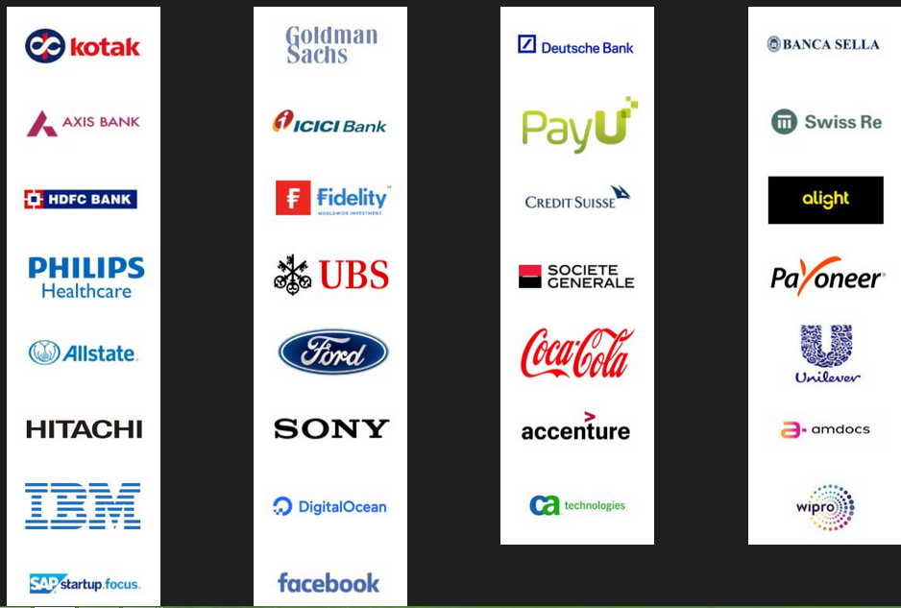
NASSCOM Industry Partnership Program

Slide 17
BANK LOANS FOR START-UPS IN INDIA
Working Capital Loan
Corporate Term Loan
Term Loan
Notes:
Working capital is the money you need to meet your day-to-day business expenses like your monthly electricity bills.

Slide 18
The Credit Guarantee Fund Scheme (CGS) for Micro and Small Enterprises
collaboration with SIDBI
can borrow term loan or working capital loan
Collection of loan is with GOI and SIDBI
The MUDRA Loan Scheme
MUDRA stands for Micro Units Development and Refinance Agency Ltd.
Shishu
Kishore
Tarun

Slide 19
Stand Up India Scheme
The Stand Up India scheme is a special scheme started by the government of India to financially empower SC/ST and women entrepreneurs.
You can borrow between Rs. 10 lakh and Rs. 1 CR to start a manufacturing, trading or service unit, which is to be repaid in 7 years.

Slide 20
SIDBI Revolving Fund for Technology Innovation
financial assistance to MSMEs
Interest rate would be as approved by the Project Approval Committee (PAC) (not be more than 5% p.a.).

Slide 21
Technology Development Programme (TDP)
Science and Engineering Research Board (SERB)
AI, AR/VR (augmented + virtual reality), automotive, telecommunication & networking, computer vision, construction, design, non-renewable energy
Government support

Slide 22
Laws for Startup
Basics of accounting and tax related laws
Choosing the type of venture
Service Agreement and Documentation
IT and Cyber Laws
Intellectual Property Rules (IP)
Industry-specific laws
Residency
Labour Laws
Contract laws and dispute resolution

Slide 23
SEZ
A special economic zone (SEZ) is an area in which business and trade laws are different from the rest of the country.
A special economic zone (SEZ) is a geographical region that is designed to export goods and provide employment.
aims include:
-increased trade
-increased investment
-job creation and effective administration.

Slide 24
To encourage businesses to set up in the zone
financial policies are introduced.
These policies typically regard:
Investing
Taxation
trading
customs
labour regulations.

Slide 25
SEZs are protected as duty-free areas for the purpose of trade, operations, duty, and tariffs.
SEZ units are self-contained and integrated having their own infrastructure and support services
SEZs are exempt from federal laws regarding taxes, quotas, labour laws and other restrictive laws in order to make the goods manufactured in the SEZ at a globally competitive price.

Slide 26

SEZS SET UP BY THE CENTRAL GOVERNMENT
SEEPZ special economic zone Mumbai, Maharashtra electronics and Gems and jewellery
Noida special economic zone Uttar Pradesh multi product
MEPZ special economic zone Chennai, Tamil Nadu multi product
Cochin special economic zone cochin, Kerala multi product
Falta special economic zone falta,West Bengal multi product

Slide 27
Export promotion schemes
Software Technology Parks (STPs)
Special Economic Zones (SEZ) Scheme

Slide 28
BENEFITS UNDER STP SCHEMES:-
Customs Duty Exemption in full on imports.
Central Excise Duty Exemption in full on indigenous procurement.
All relevant equipment / goods including second hand equipment can be imported (except prohibited items).
Equipment can also be imported on loan basis/lease.
100% FDI is permitted through automatic route.
Sales in the DTA up to 50% of the FOB value of exports permissible.
Use of computer imported for training permissible subject to certain conditions.
Depreciation on computers at accelerated rates up to 100% over 5 years is permissible.

Slide 29
BENEFITS UNDER SEZ SCHEMES:-
Duty free import/domestic procurement of goods for development, operation and maintenance of SEZ units
100% Income Tax exemption on export income for SEZ units under Section 10AA of the Income Tax Act for first 5 years, 50% for next 5 years thereafter and 50% of the ploughed back export profit for next 5 years.
Exemption from Central Sales Tax, Exemption from Service Tax and Exemption from State sales tax. These have now subsumed into GST and supplies to SEZs are zero rated under IGST Act, 2017.
Other levies as imposed by the respective State Governments
Single window clearance for Central and State level approvals.
This scheme has a significant impact on future exports & employment. About 230 IT-ITeS specific SEZs have been notified by the DOC.

